Slide 1

Versions
Current Version: 1.7.0 (Oct 17, 2016)
Version Used: 1.5.2

Slide 2
Agenda
Topics
Introduction
Flume Terminologies
Data Flow Model
Source & Sink
Channel
Test Yourself
Agent configuration
Installation procedure
Assignment
Topics
Limitations

Slide 3































Big Data Ecosystem
Streaming Engines
Data Store
Data Processing
Peripherals
Data Services
Distributions
Cloud Exposure
3

Slide 4
Introduction
What is Apache Flume?
Flume is a distributed, reliable, and available service for efficiently collecting, aggregating, and moving large amounts of streaming data.
Why Apache Flume ?
Flume was developed to allow to flow data from a source into the Hadoop environment.

Slide 5




Flume Terminologies
Event:
A Flume event is defined as a unit of data flow.
Source:
Consumes events delivered to it by an external source.
Channel:
Channel keeps the event until it’s consumed by a Flume sink.
Sink:
Removes the event from the channel and puts it into an external repository.
Agent:
Any physical Java virtual machine running Flume. It is a collection of sources, sinks and channels.

Slide 6
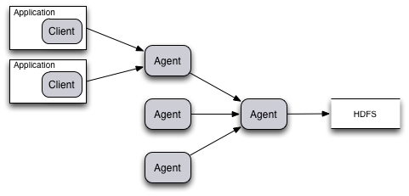
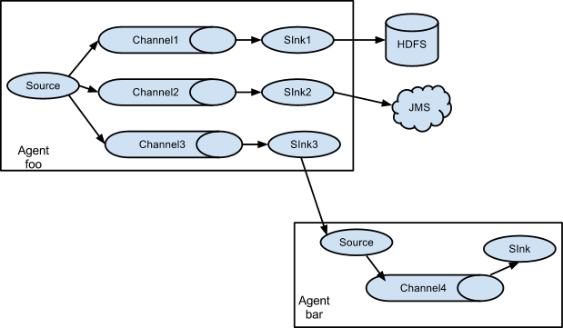
Data Flow model
A Flume source consumes events delivered to it by an external source like a web server.
When a Flume source receives an event, it stores it into channel.
The sink removes the event from the channel and puts it into an external repository like HDFS.
Reliability:
Flume uses a transactional approach to guarantee the reliable delivery of the events.
The events are removed from a channel only after they are stored in the channel of next agent or in the terminal repository.

Slide 7
Source & Sink
Source:
Flume provides support for around 15 types of sources, few are
Sink:
Flume provides support for around 13 types of sinks, few are
Sources
Avro Source
Thrift Source
Exec Source
JMS Source
Spooling Directory Source
Taildir Source
Kafka Source
NetCat Source
Sequence Generator Source
Syslog Sources
HTTP Source
Stress Source
Legacy Sources
Scribe Source
Sinks
HDFS Sink
Hive Sink
Logger Sink
Avro Sink
Thrift Sink
IRC Sink
File Roll Sink
Null Sink
HBaseSinks
MorphlineSolrSink
ElasticSearchSink
Kite Dataset Sink
Kafka Sink

Slide 8
Channel
Flume provides support for around 5 types of channels.
Memory Channel
File Channel
JDBC Channel
Spill able Memory Channel
Pseudo Transaction Channel
Memory: The events are stored in an in-memory queue with configurable max size.
File: The events are stored on disk as files. Ensures durability.
Spill able Memory: The events are stored in an in-memory queue and on disk. The in-memory queue serves as the primary store and the disk as overflow.
JDBC: The events are stored in a persistent storage that’s backed by a database.
Pseudo Transaction Channel: The Pseudo Transaction Channel is only for unit testing purposes and is NOT meant for production use.

Slide 9
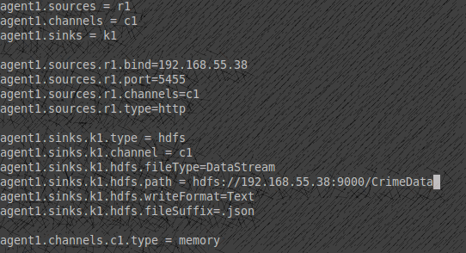
Agent Configuration
HTTP Source
HDFS Sink
Memory Channel

Slide 10

Limitations
How large an event can be - for instance, it cannot be larger than what you can store in memory or on disk on a single machine .
If you are trying to do a single bulk load of data into a Hadoop cluster then Flume will still work, but it is probably overkill for your situation.
It probably won’t work well if you plant to change topologies every day, because reconfiguration takes some thought and overhead.

Slide 11


Installation procedure
For installation of Flume in Ubuntu, follow the below document:
http://hadooptutorial.info/apache-flume-installation/
Official Site :
https://flume.apache.org/

Slide 12


Test Yourself
Answer the following questions:
What does an agent include?
Can I run two instances of the flume on the same machine?
An Agent includes – Source, Channel, Sink
Yes it is possible
Which channel is faster – Memory, File, JDBC?
Can flume distribute data to multiple destinations?
​Memory is faster however has the risk of data loss
Yes, it supports multiplexing flow. The event flows from one source to multiple channels & multiple destinations

Slide 13
Assignment
Install Flume
Configure the flume agent as follows:
Agent : HTTP Source
Memory Channel
HDFS Sink
Place the below JSON data into HDFS

